Slide 1


Department of CS&E
PROJECT WORK PHASE-1 (18CSP77) PRESENTATION
2021-22
PROJECT TOPIC: “LOW LIGHT IMAGE ENHANCEMENT USING DEEP LEARNING”
PROJECT GROUP ID: 21CS35
Presentation By:
Charish Patel M N 1VE18CS041
Chunith Gowda G S 1VE18CS043
Rashmi S 1VE18CS134
Shirisha K S 1VE18CS146
Guided By:
Mr. Balaji K
Assistant Professor
Dept. of CS&E
SVCE
DEPARTMENT OF COMPUTER SCIENCE AND ENGINEERING
SRI VENKATESHWARA COLLEGE OF ENGINEERING
VIDYANAGAR,BANGALORE-562157

Slide 2
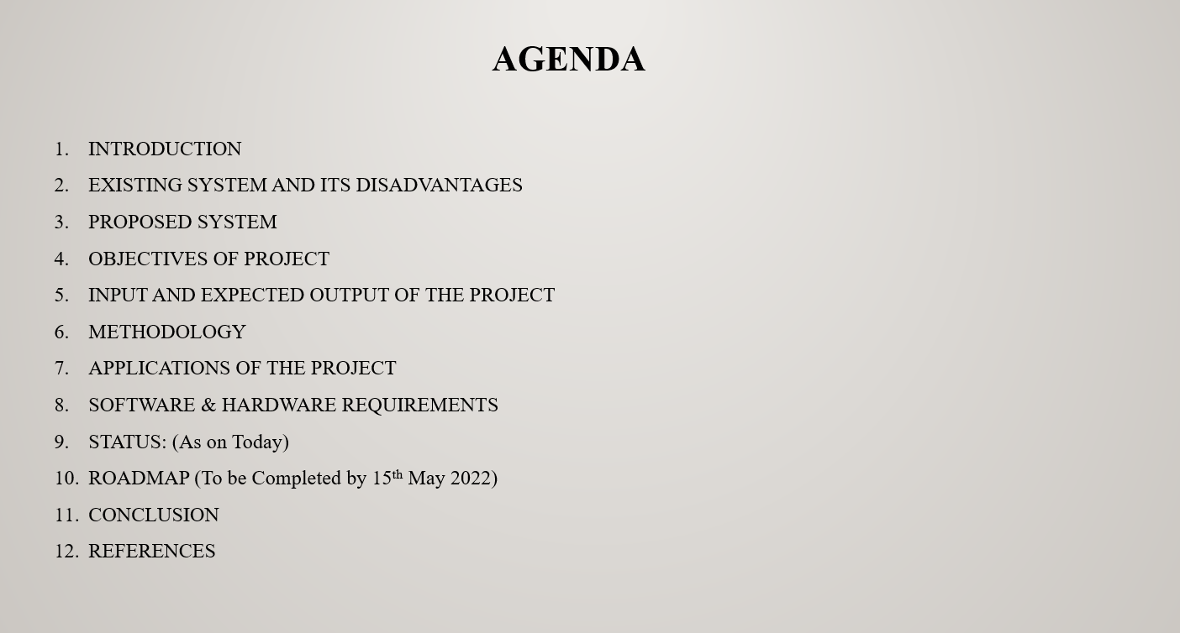
Low Light Image Enhancement Using Deep Learning

Slide 3
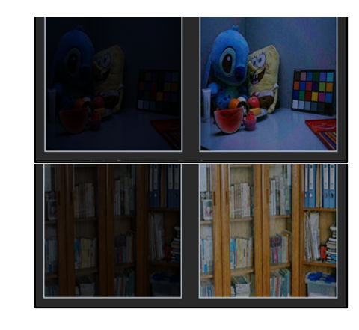
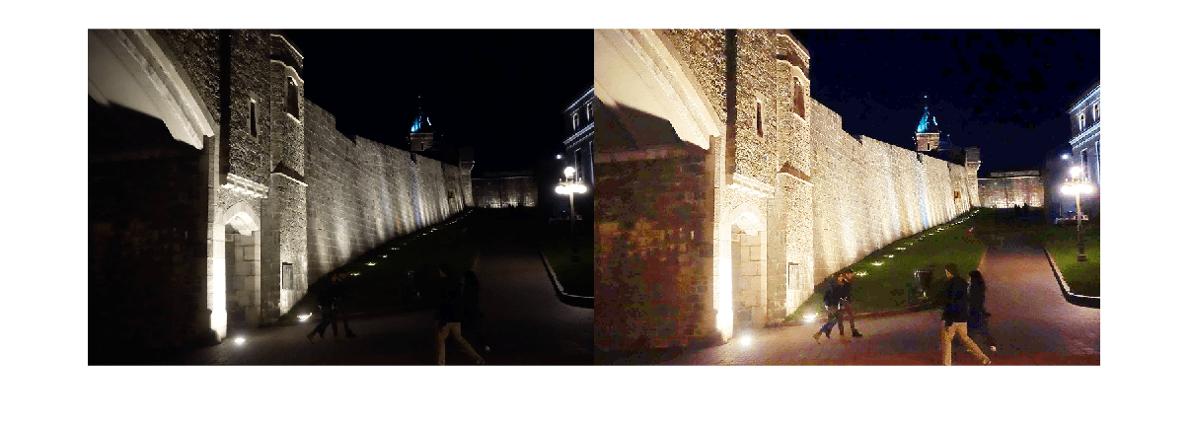
Low Light Image Enhancement Using Deep Learning
INTRODUCTION
Low contrast, poor visibility, and noise characterizes images captured in low-light circumstances. These limitations provide a difficulty to human vision.
Favors high-visibility images, and many intelligent systems that rely on computer vision algorithms, such as all-day autonomous driving and biometric recognition.

Slide 4
Low Light Image Enhancement Using Deep Learning
EXISTING SYSTEM AND ITS DISADVANTAGES
Sl No | EXISTING SYSTEM | DISADVANTAGES
1 | SRIE (Super Resolution Image Enhancement). | Limited Super-Resolution. High Time Consumption. Bleaching.
2 | Retinex. | Graying out. Poorly with unnatural images. Washout Appearance.
3 | Enlighten GAN | Realistic but not Real. Difficult for training and huge computation. Chance of creating Fake patterns.

Slide 5
Low Light Image Enhancement Using Deep Learning
PROPOSED SYSTEM
Our proposed network use Attention based Broadly Self-guided Network (ABSGN) a top-down self-guidance architecture to better exploit image.
Firstly, we pass the input image through a Conv+ReLU layers to obtain a main feature map with 32 channels.
At the lowest resolution layer, we offer a Global Spatial Attention (GSA) . The framework is implemented with PyTorch.
At last Down-sampling and normalization layers that break the relations of neighboring pixels are those are discarded.

Slide 6
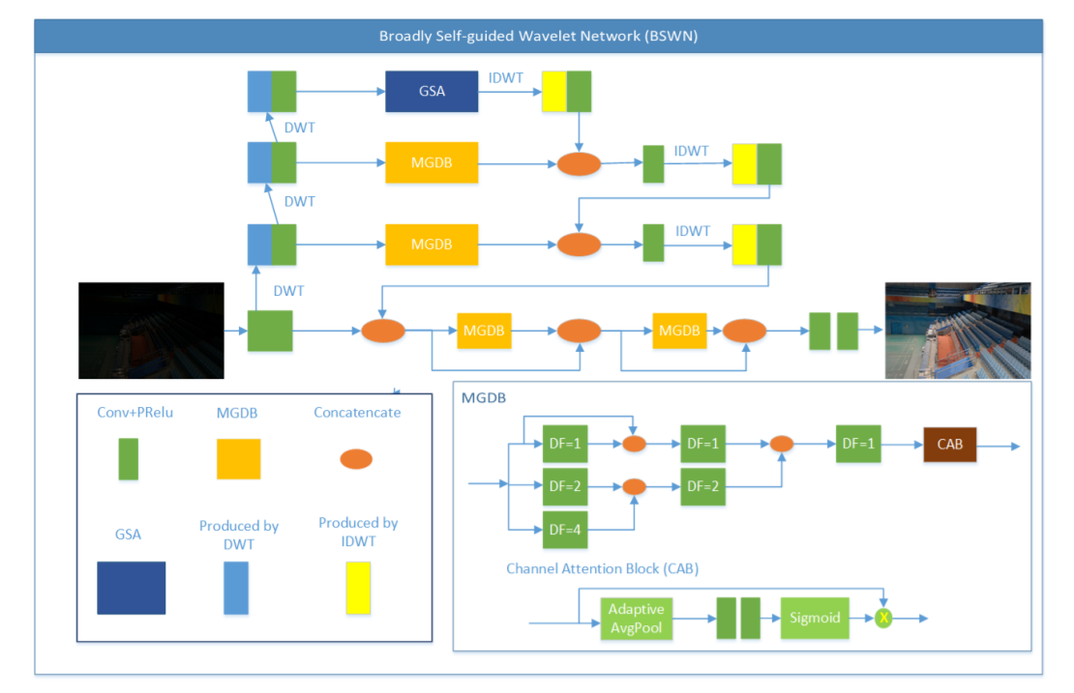
Low Light Image Enhancement Using Deep Learning
Illustration of our Proposed System

Slide 7
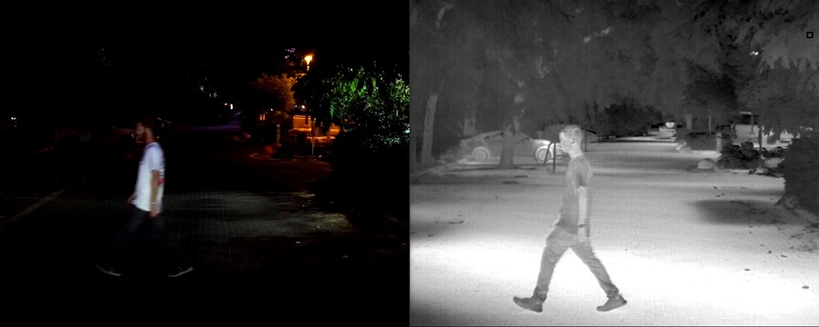
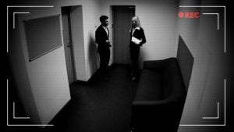
Low Light Image Enhancement Using Deep Learning
OBJECTIVES OF PROJECT
To illuminate the images captured in low light conditions.
Minimize the image quality degradation after enhancement.
Coping up with diverse lighting conditions such as non uniform and poor lighting conditions.
To brighten up the image while preserving the inherent color and details.
CCTV Image
Autonomous Car Captured Image

Slide 8
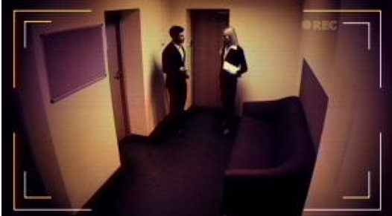
Low Light Image Enhancement Using Deep Learning
METHODOLOGY
Conv+ReLU
IDWT
DWT
GSA
INPUT
MGDB
Concatenate
Image From (Conv+ReLU)+ IDWT
MGDB
Output
Dept of CSE, SVCE

Slide 9
Low Light Image Enhancement Using Deep Learning
INPUT AND EXPECTED OUTPUT OF THE PROJECT
Input
Output

Slide 10
Low Light Image Enhancement Using Deep Learning
APPLICATIONS OF THE PROJECT
The implementation can be used to Enhance the Low lighted images into actual normal image or images taken in dark to attain clarity.
Used to Enhance images in cameras.
Autonomous driving vehicles can use low light image enhancement to restore original image during night times which will help self driving during night times.
Human Face recognition can use the proposed system
CCTV surveillance camera.
Dept of CSE, SVCE

Slide 11
Low Light Image Enhancement Using Deep Learning
SOFTWARE & HARDWARE REQUIREMENTS
Hardware Requirements:
• 8 /16 GB free disk space
• Quad-core Intel or AMD processor, 2.5 GHz or High
Software Requirements:
• Operating System: Windows 8 or newer /Linux/Mac OS
• Python V3 and IDE
• Python modules: PyTorch, OpenCV-python, NumPy, math, PIL.
Dept of CSE, SVCE

Slide 12
Low Light Image Enhancement Using Deep Learning
CURRENT STATUS
Research and Analysis
Resource Collection
Current State
Next State
Dept of CSE, SVCE

Slide 13

PROJECT ROADMAP
Problem Identification
This is the phase where we worked on identifying the problem
Research and Analysis
January 1-14
Development and Design
April
Debugging and Prepare to Launch
2 WEEKS December 5-19
2 Months
February-March
April-May
02
01
03
1week
December 22-29
3 Weeks
January 15-February 6
May
Launch
Problem Approval and Synopsis
Testing
Resource and knowledge gain

Slide 14
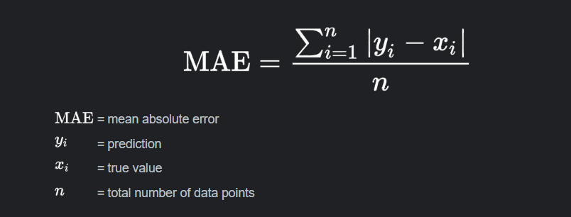
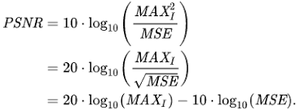
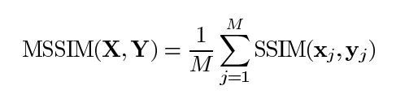
Low Light Image Enhancement Using Deep Learning
CONCLUSION
The proposed project serves as a Deep Learning model for low light image enhancement.
Many real time applications like CCTV surveillance systems, animal detection systems, theft detection systems etc., face the drawback of under performance when used in low light conditions.
The proposed model can be integrated with these Realtime systems as a pre-processing unit, which leads to the improvement in performance and proper utilization of the potential of the model.
Accuracy Factors Used : PSNR , SSIM , MAE
Dept of CSE, SVCE

Slide 15
Low Light Image Enhancement Using Deep Learning
REFERENCES
[1] Chunle Guo1, Chongyi Li1, Jichang Guo1, Chen Change Loy, Junhui Hou, Sam Kwong, Runmin Cong,”Zero-Reference Deep Curve Estimation for Low-Light Image Enhancement”, Beijing Jiaotong University, 22 March 2020.
[2] Gershon Buchsbaum. A spatial processor model for object colour perception. J. Franklin Institute, 2016.
[3] Vladimir Bychkovsky, Sylvain Paris, Eric Chan, and Fredo ´ Durand. Learning photographic global tonal adjustment with a database of input/output image pairs. In CVPR, 2019.
[4] Jianrui Cai, Shuhang Gu, and Lei Zhang. Learning a deep single image contrast enhancer from a multi-exposure image. IEEE Transactions on Image Processing, 2018.
[5] Chen Chen, Qifeng Chen, Jia Xu, and Koltun Vladlen. Learning to see in the dark. In CVPR, 2018.
[6] Yusheng Chen, Yuching Wang, Manhsin Kao, and Yungyu Chuang. Deep photo enhancer: Unpaired learning for image enhancement from photographs with gans. In CVPR, 2018.
[7]DataSet:Darknet:https://www.kaggle.com/peterfriedrich1/darknet-2020-getting-started
Dept of CSE, SVCE

Slide 16
THANK YOU

